Slide 1

A Comparative Analysis of DC-DC Converters for Renewable Energy System
Submitted by:
Yalavarthi Lalith Sai Ram
2K20/EE/308
Yasharth Sharma
2K20/EE/312
Submitted To:
Prof. Dr. SIKANDAR ALI KHAN

Slide 2
INTRODUCTION
Electrolysis is an electrochemical process in which electrical energy is the driving force for chemical reactions. An electrolytic compound is decomposed by passing a current through it.
Water is decomposed to hydrogen and oxygen by passing a current through it in the presence of suitable substances called electrolytes. Electric current causes positively charged hydrogen ions to migrate to the negatively charged cathode, where a reduction takes place in order to form hydrogen atoms.
The atoms formed will combine to gaseous hydrogen molecules (H2). On the other hand, oxygen is formed at the other electrode (the positively charged anode). The stoichiometry of the reaction is two volumes of hydrogen to one volume of oxygen
The most important part in the construction of electrolysis units is to use adequate electrodes to avoid unwanted reactions which produce impurities in the hydrogen gas.

Slide 3
Methods of hydrogen production through water electrolysis
Despite the fact in the discovery of electrolytic water decomposing was first observed in acidic water. In industrial plants alkaline medium is preferred because corrosion is more easily controlled and cheaper construction materials can be used for acidic electrolysis technology.
Other methods of hydrogen production such as proton exchange membrane electrolysis and steam electrolysis have been developed in recent years. Hydrogen could also be generated as a byproduct during chloralkali production.
The stored hydrogen is fed to a fuel cell to produce electricity. The main aim of this analysis is to obtain optimization of the converter efficiency.
The converter switches which have been used are superjunction MOSFETs with reduced forward resistance in the conduction mode and improved dynamic characteristics in the switching transients. The converter strategy control allows a zero voltage transient on the power switches of the

Slide 4
Renewable Electrolysis
Renewable electrolysis is a process that uses renewable electricity to produce hydrogen by passing an electrical current through water. Renewable energy sources such as photovoltaics, wind, biomass, hydro power, and geothermal can provide clean, sustainable electricity
Renewable electrolysis is hindered by the difficulty of producing hydrogen from renewable sources in a cost-competitive manner. To realize the potential of renewable electrolysis, the costs of renewable technologies as well as the capital requirements for electrolysers must be lowered, and renewable electrolysis systems must be optimized.
Factors that limit widespread use of renewable technologies include inherent variability and seasonal energy production. The hydrogen produced from renewable electrolysis can be used in fuel cells or internal combustion engines to produce electricity during peak demand or low power production. This hydrogen can also be used as transportation fuel

Slide 5
Hydrogen production from RES
The RE system components have substantially different voltage-current characteristics and they are integrated on the DC bus through power conditioning devices for optimal operation. Electrolytic hydrogen offers a promising alternative for long-term energy storage of renewable energy (RE). The long-term excess energy with respect to load demand has been sent to the electrolyser for hydrogen production and then the fuel cell has utilized this stored hydrogen to produce electricity when wind and solar energies are insufficient. The DC power required by the electrolyser system is supplied by the DC-DC converter.
Electrolysis of water is the best way to produce eco friendly hydrogen because:
(i) Water on earth is abundant
(ii) Hydrogen is provided from abundant renewable energy Sources.
(iii) Oxidation of Hydrogen for the production of electrical energy (in fuel cells) produces only water, which can be recycled.

Slide 6
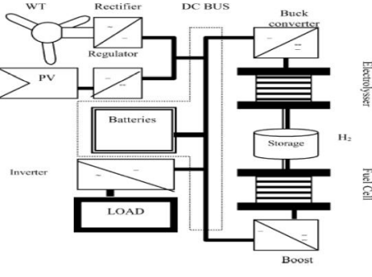
The cost of hydrogen production from solar energy is rather high, approximately 100$/GJ. Except the photovoltaic panels required for this process, water electrolysis units are also expensive. Aeolic energy usage cost for the production of hydrogen is nowadays 15- 20$/GJ
The basic model to describe the dynamics of an Renewable energy system with Hydrogen storage (RESHS) . It integrates sub-models of the electrolyser, the fuel cell, the batteries, the power interfaces (buck and boost converters) and the storage system. Interdependency issues (hydrogen consumption cannot exceed production) are taken into account. Special attention is given to the characterization of the system’s major components in the transient state, and use simple and realistic assumptions to describe the behaviour for short and long-term operation of the RESHS. During periods of excess load demand over the input renewable resources, a fuel cell operating on stored hydrogen would provide a balance of power. To ensure a proper flow of power between the system elements, the available energy from different sources are coupled to a low voltage DC bus. A direct connection of DC bus to the electrolyser is not suitable because it lacks the ability to control the power flow between renewable input source and the electrolyser. Therefore, a power conditioning system, usually a DC-DC converter is required to couple the electrolyser to the system bus. High-frequency (HF) transformer isolated, DC-DC converter is suitable for this application due to their small size, light weight and reduced cost.

Slide 7
DC-DC CONVERTER CIRCUIT TOPOLOGIES
1. With Transformer
2. Without Transfor
Analysis of selected converters The selected converters are designed for the worst operating conditions of: minimum input voltage, Vin = 48 V; maximum output voltage, Vo = 200 V; and maximum output power( 2 kW for each cell); switching frequency, fs = 10 kHz; inverter output pulse-width, δ = π.
The basic circuit diagram of the DC-DC converter is a modified series (LCL type) resonant converter with capacitive output filter. The converter operates in lagging PF mode for very wide variations in load and supply voltage, thus ensuring ZVS for all the primary switches.
The peak current through the switches decreases with load current. The fundamental component of the square wave input voltage is applied to the resonant network and the resulting sine waves of current and voltage in the resonant circuit are computed using classical AC analysis.
For a rectifier with an inductor output filter, a sine wave voltage appears at the input, and the average arrives at the resulting DC output voltage

Slide 8
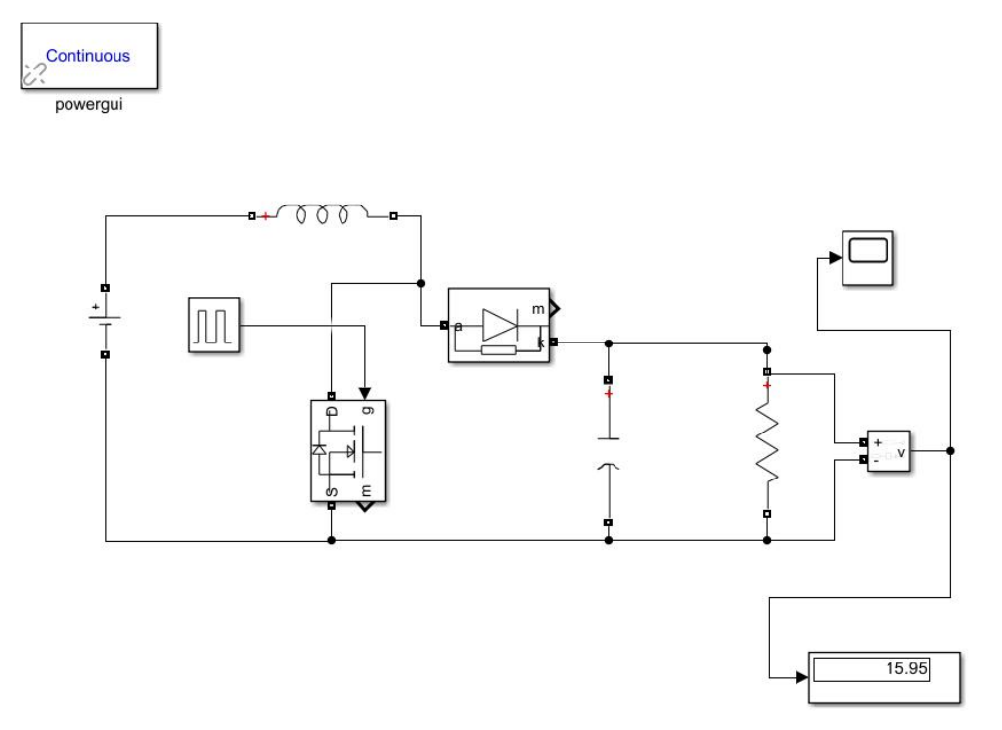
CIRCUIT DIAGRAM

Slide 9
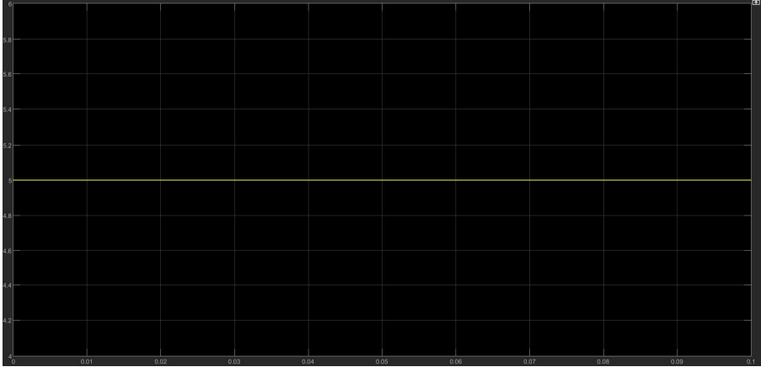
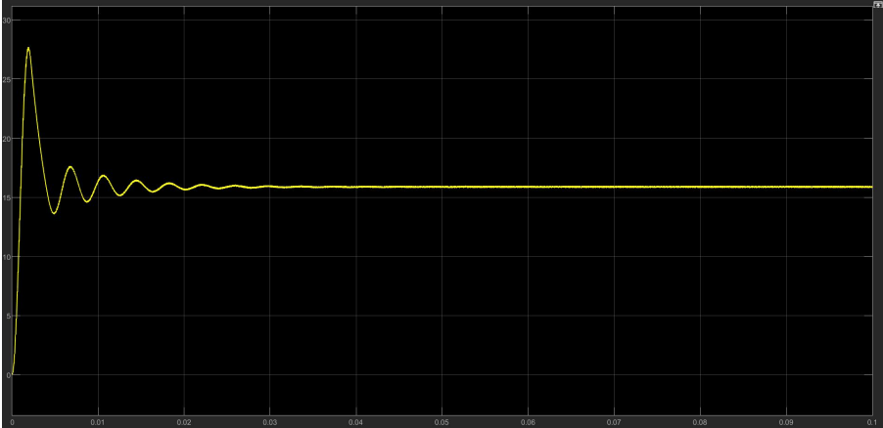
INPUT
OUTPUT

Slide 10
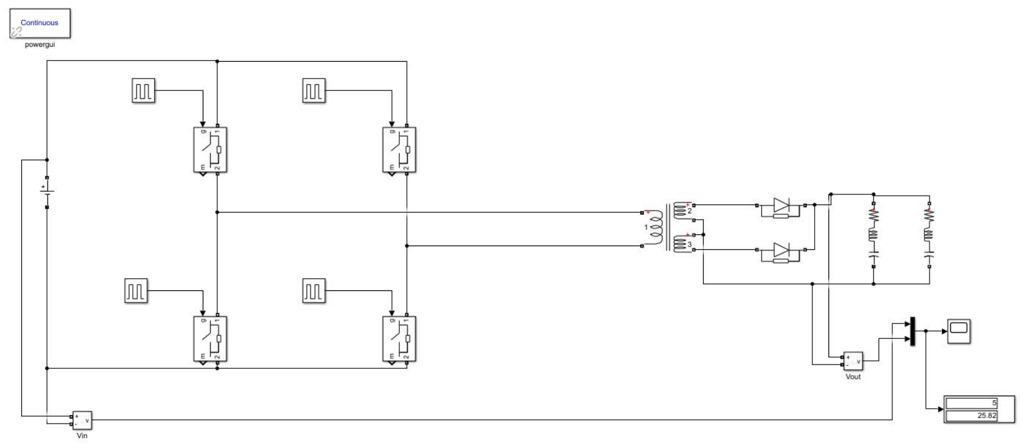
WITH TRANSFORMER
CIRCUIT DIAGRAM

Slide 11
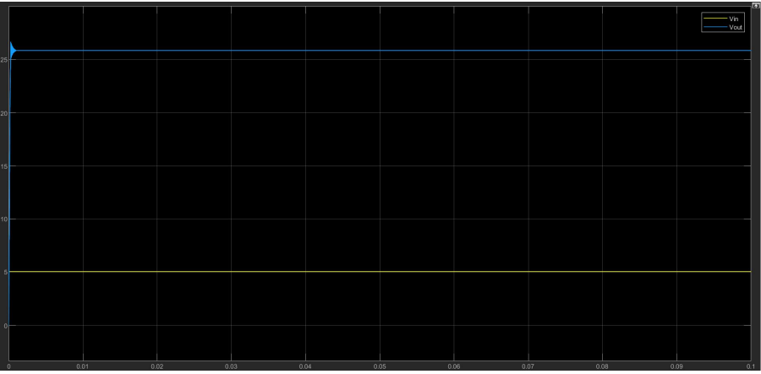
INPUT AND OUTPUT IN A SINGLE SCOPE

Slide 12
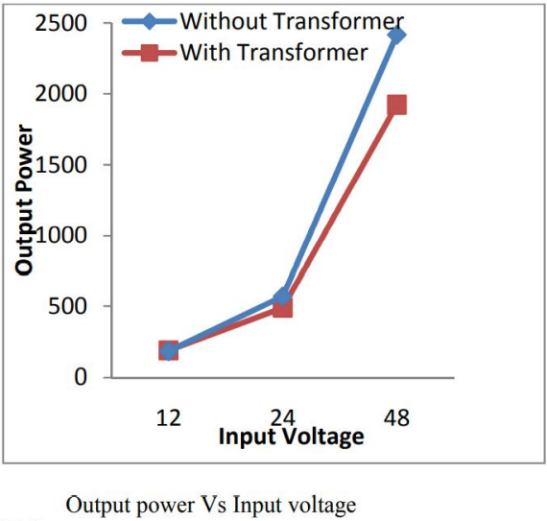
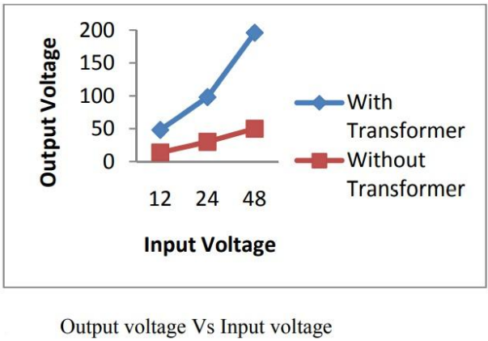
COMPARISON OF DC-DC CONVERTER WITH AND WITHOUT TRANSFORMER

Slide 13
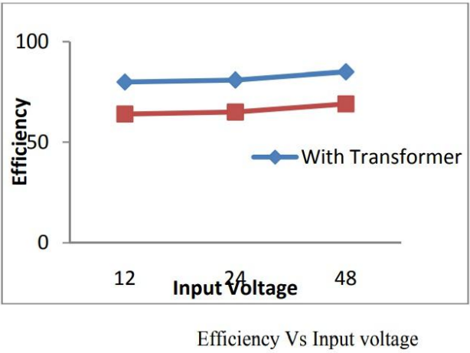
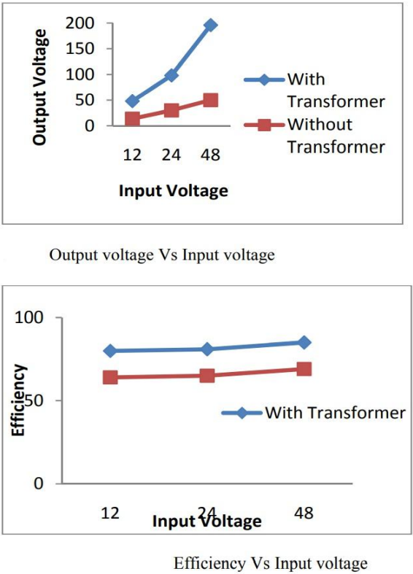

Slide 14
CONCLUSION
This simulation portrays a comparative analysis of DC-DC Converters for Renewable Energy System . The simulation and experimental results show that the power gain obtained by this method clearly increases the hydrogen production and storage rate from wind-PV systems.
It has been proved that DC-DC converter with transformer has the desirable features for electrolyser application. Theoretical predictions of the selected configuration have been compared with the MATLAB simulation results. The converter operates in lagging PF mode for a very wide change in load and supply voltage variations, thus ensuring ZVS for all the primary switches.
The peak current through the switches decreases with load current. The simulation and experimental results indicate that the output of the inverter is nearly sinusoidal. The output of rectifier is pure DC due to the presence of LC filter at the output. It can be seen that the efficiency of DC-DC converter with transformer is 15% higher than the converter without transformer

Slide 15
REFERENCES:
Rai, Dr. Jitendra. (2016). Design and Analysis of DC-DC Boost Converter. IJARI. 4. 499-502.
Biswal, Mousumi & Sabyasachi, Sidharth. (2012). A Study on Recent DC-DC Converters. International Journal of Engineering Research and Applications (IJERA). 2. 657-663.
"Design and implementation of a DC-DC boost converter for continuous hybrid power system," 2017IEEE 9th International Conference on Humanoid, Nanotechnology, Information Technology, Communication and Control, Environment and Management (HNICEM), 2017, pp. 1-5, doi: 10.1109/HNICEM.2017.8269547.
Dr. P.S. Bhimra. Power Electronics. Khanna
publishers. New Delhi, India

